Slide 1

M&IS Data Shop
Jeffrey Jones Programmer/Database Designer | Duane Aubin MS Excel™ Development & Training
Accuracy | Efficiency | Accountability |Productivity | Profitability | Responsibility |Safety

Slide 2
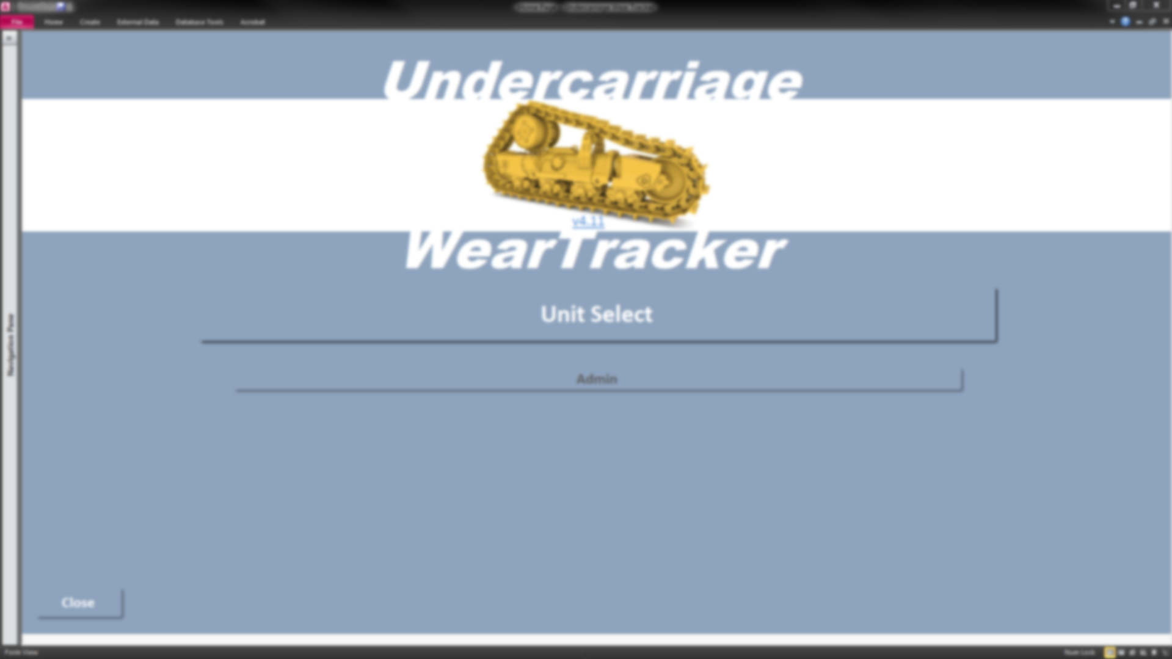
Undercarriage Wear Tracker

Slide 3
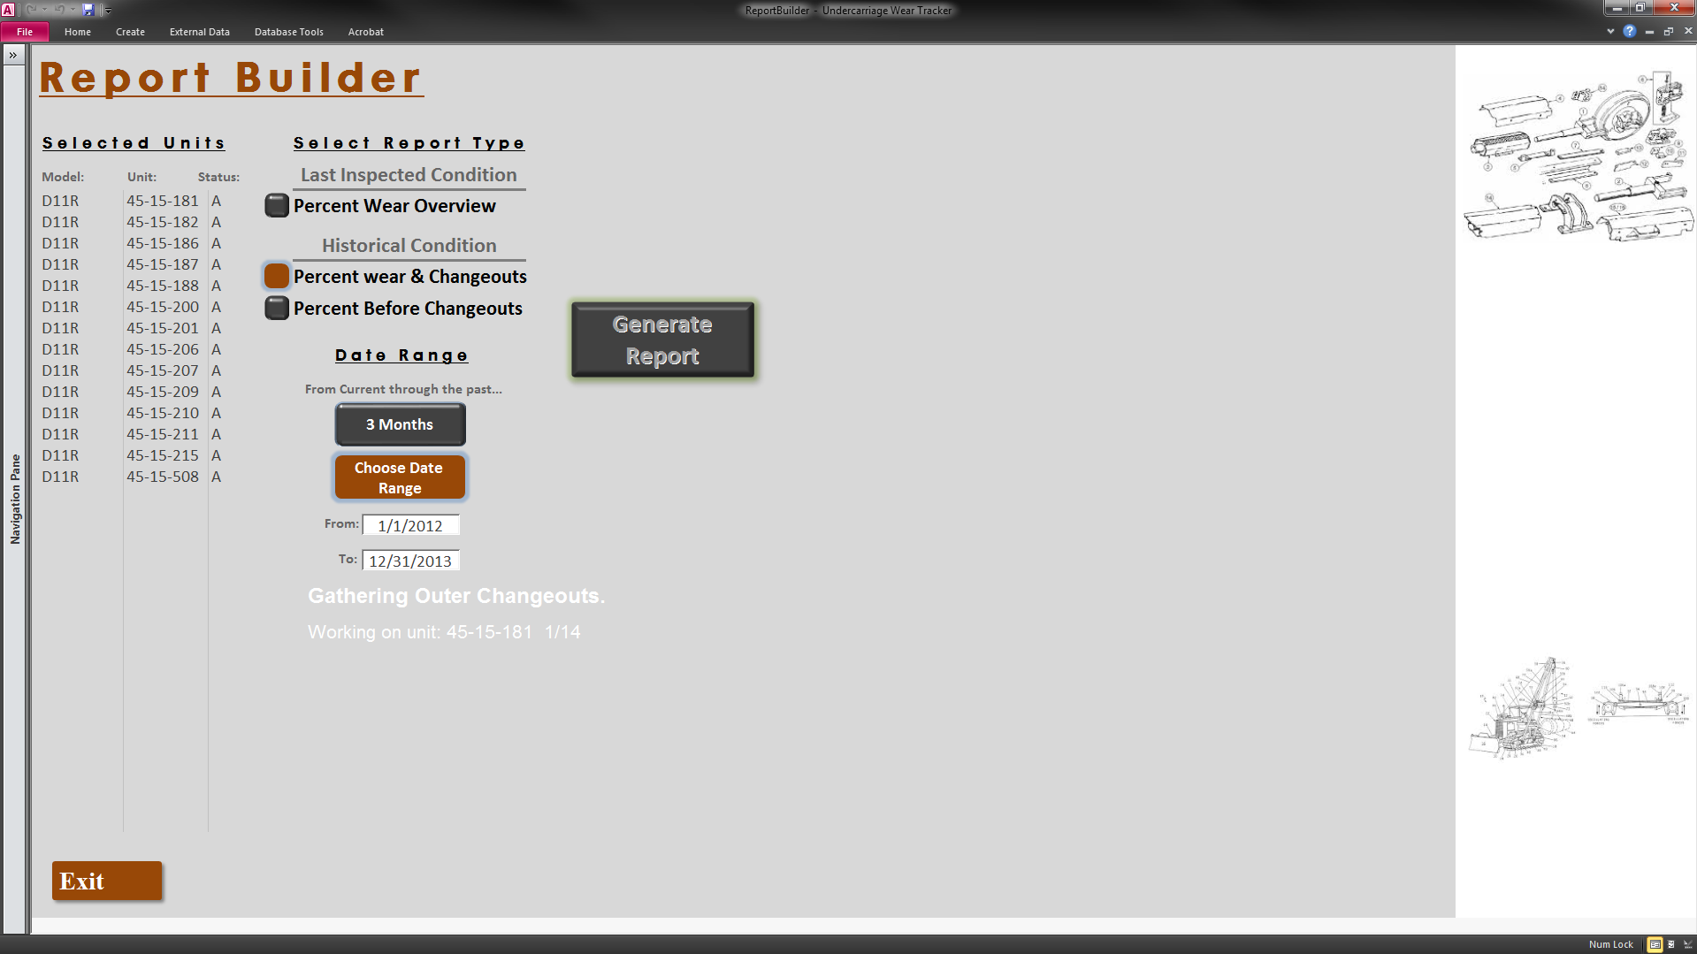
Simple Inspector interface; select units, report and time frame, click a button, and the database scours years of history of entire fleet (ML/AN, etc.) to produce…

Slide 4
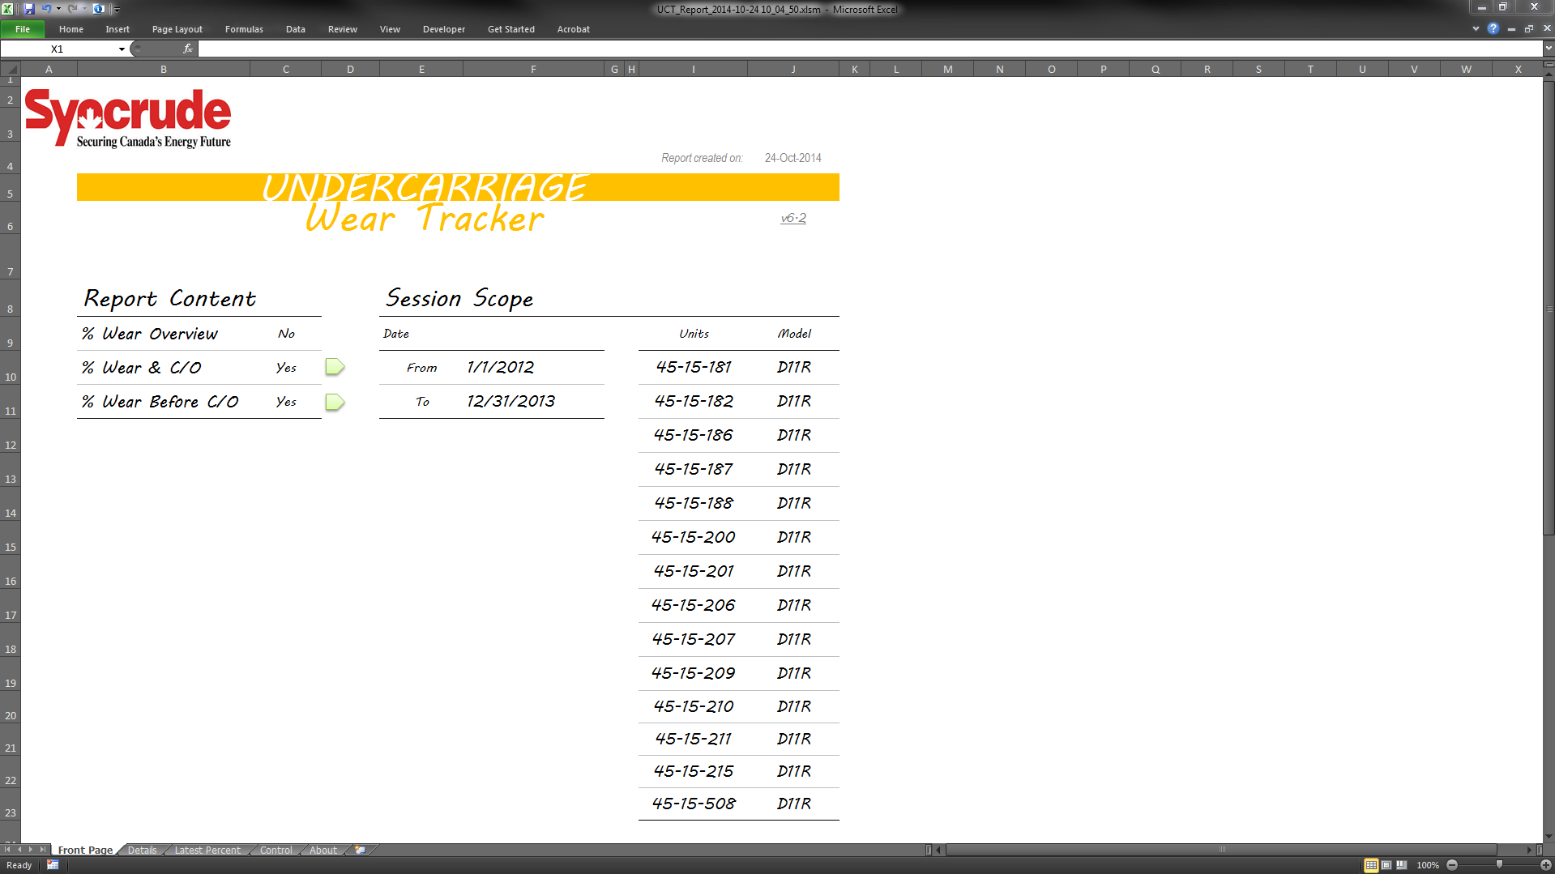
…report package that includes…

Slide 5
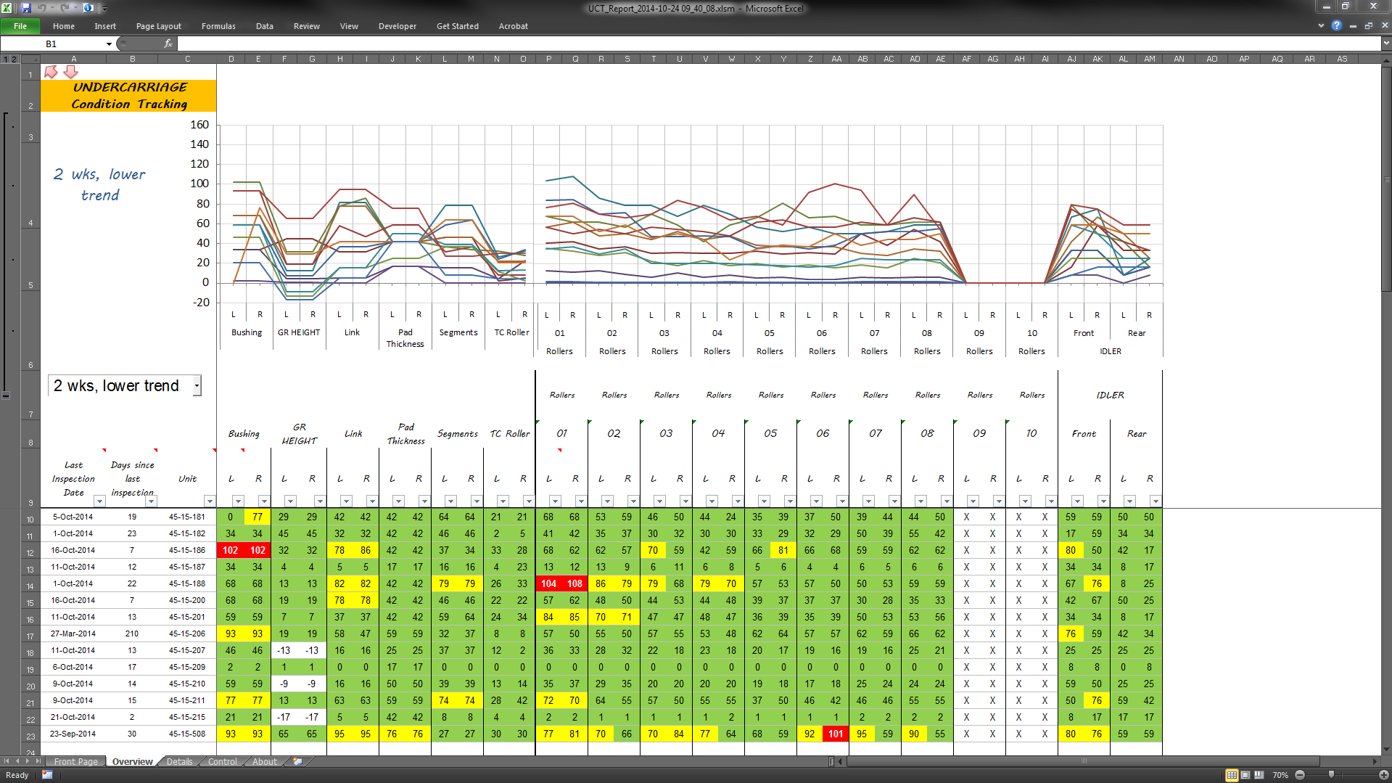
Overview of all units in report, for all components, with forecasting...

Slide 6
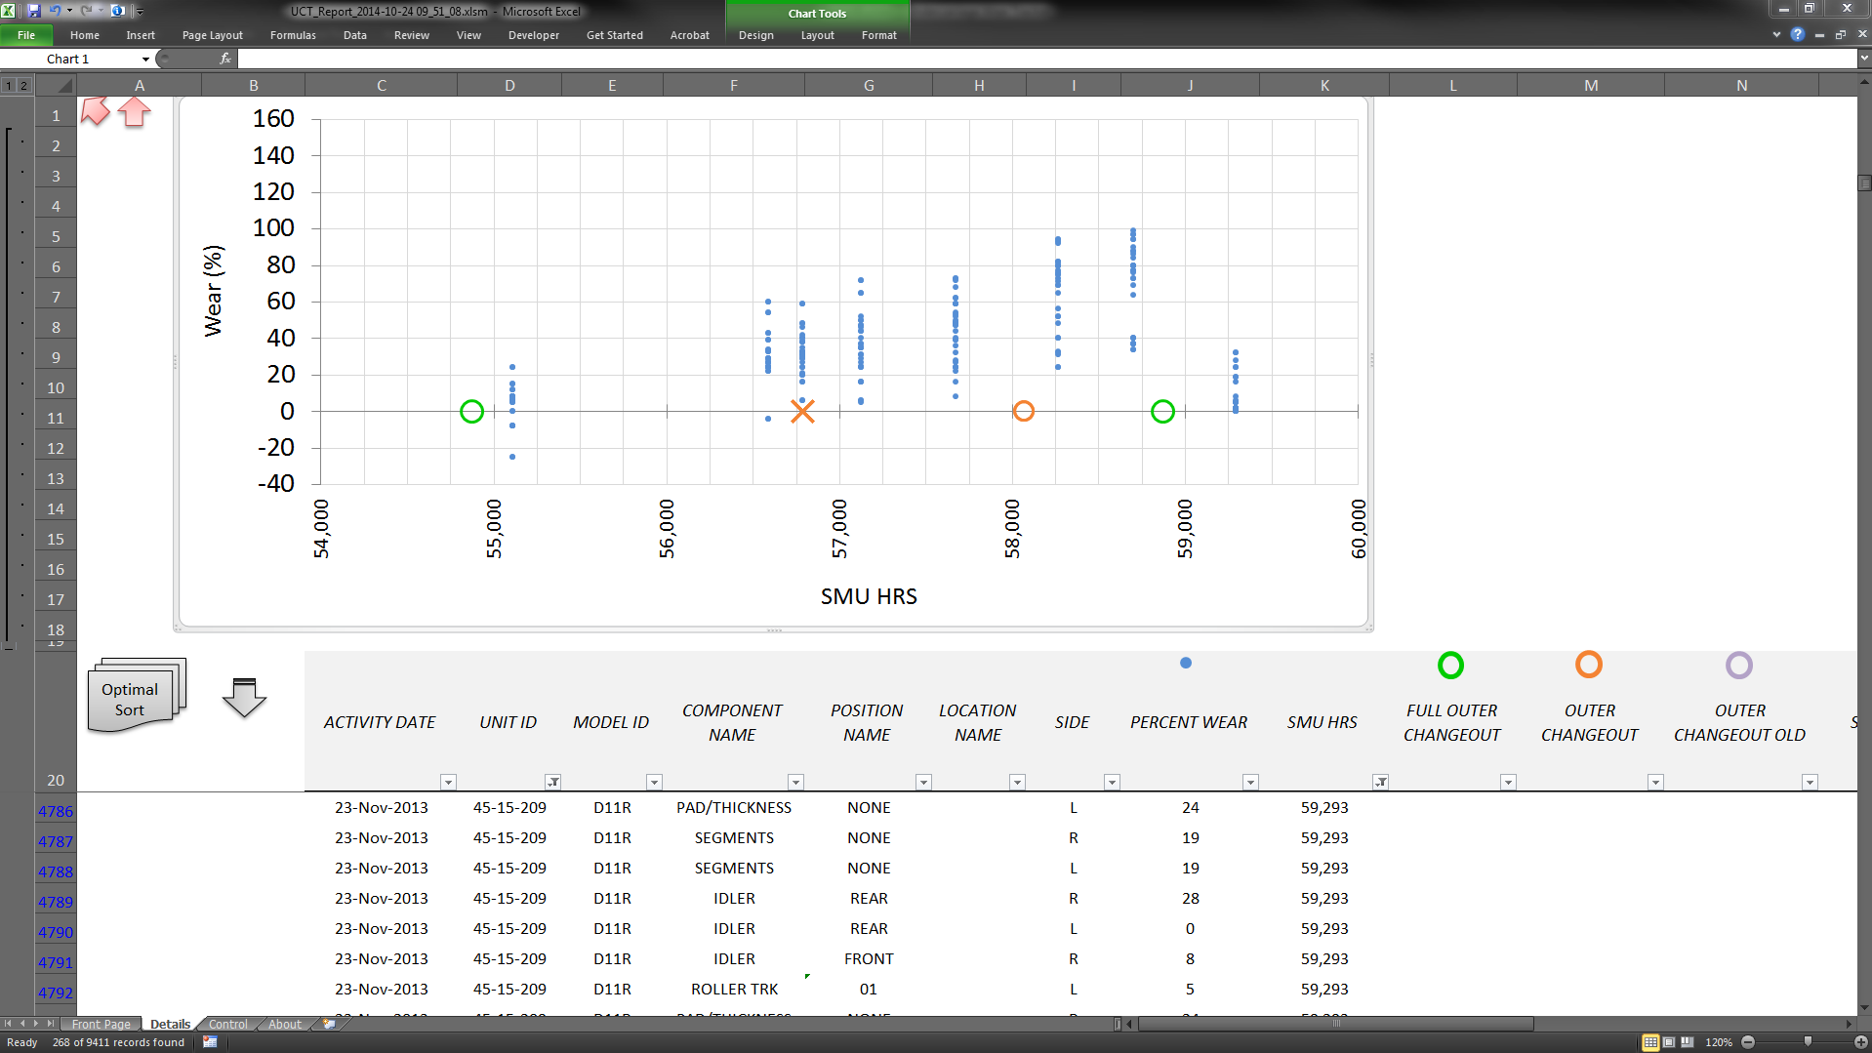
Details, all units in report, by component, including various changeout types…

Slide 7
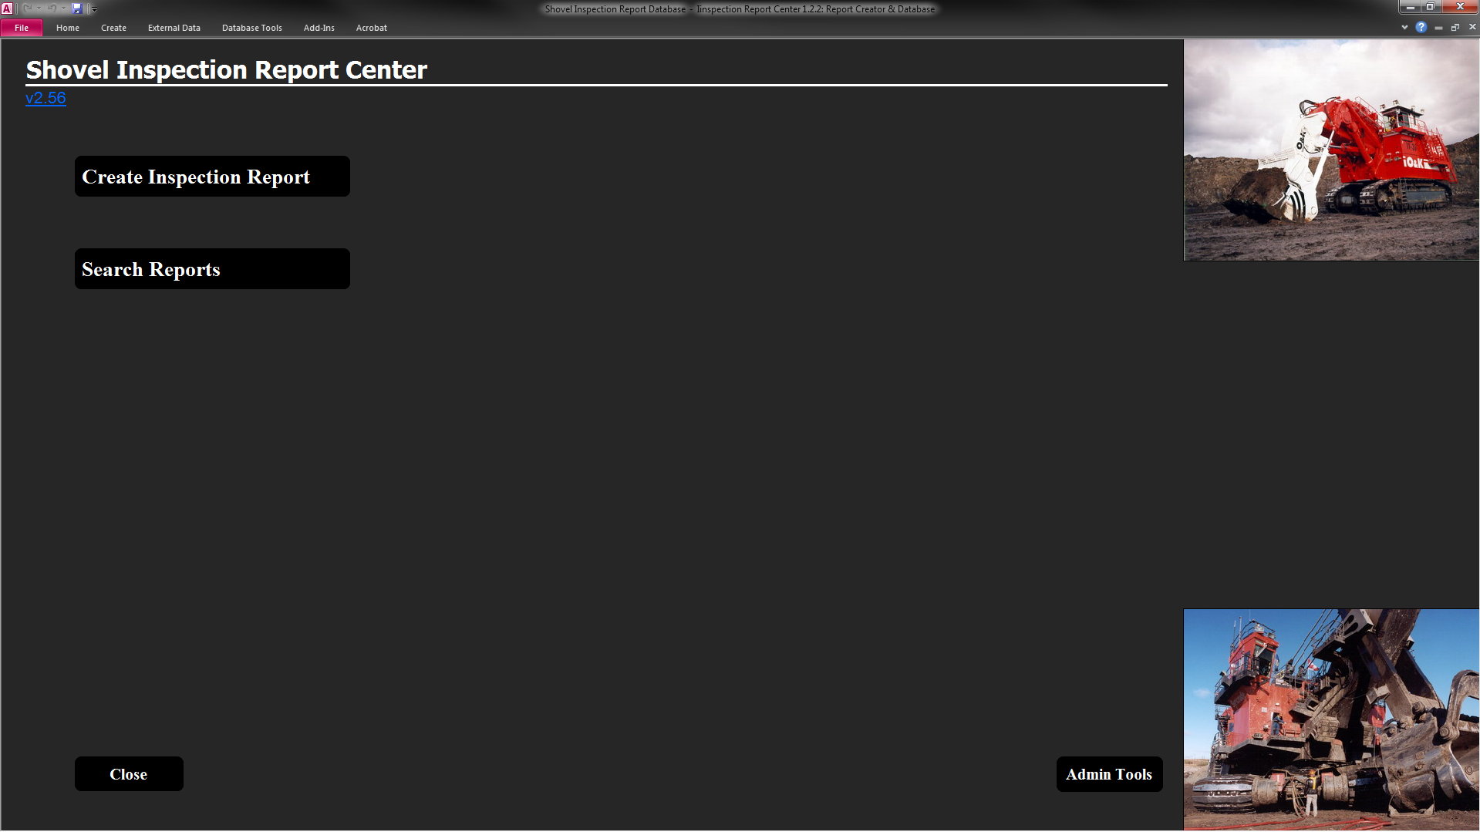
Shovel Inspection Report Centre
Clean, minimalist layout with few options guiding eyes to focus on work….

Slide 8
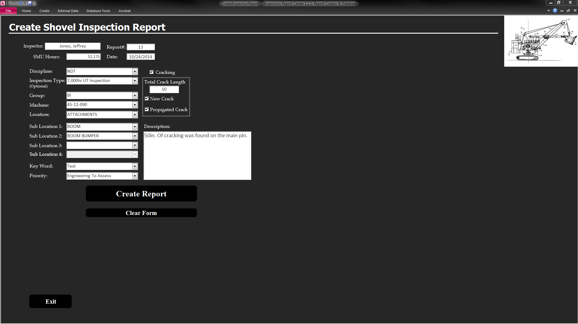

Slide 9
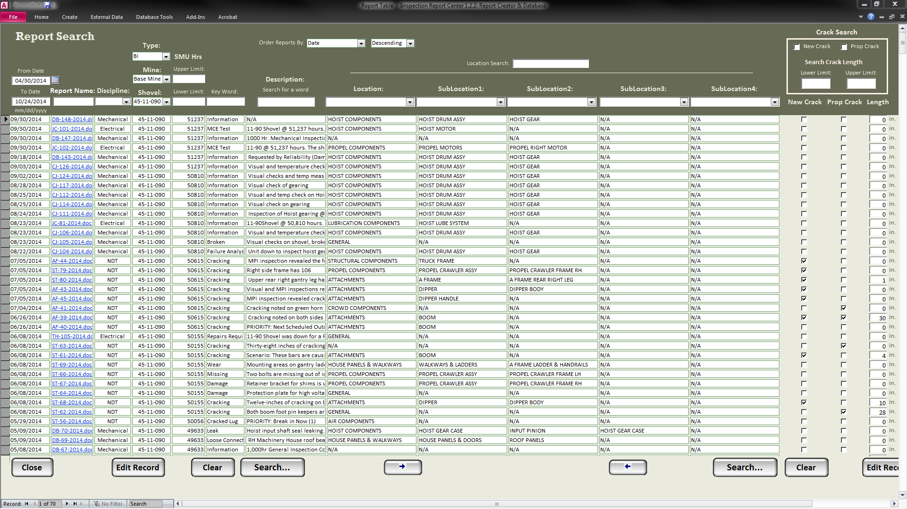

Slide 10
Master Logs
Compliance Monitoring Enhancement Phase 1 includes a much faster, more accurate Inspector interface as well as reporting tools that connect to sources and tally the data automatically in real-time; reducing reporting from manual, requiring days, down to instant, on-demand.

Slide 11
Compliance Monitoring Ecosystem
Phase 2, migration to Access database platform, providing seamless multi-user access, dynamic reporting, in addition to many other stability and functionality capabilities.

Slide 12
Weld Procedure Database

Slide 13
Leak Trends
Each cell above, for each of several areas (Conversion North, Conversion South, Hydrogen-Environmental, etc.) was updated manually, taking up to ten business days to complete, and only completed twice per year. Now, it updates instantly as data is input, providing near real-time updates on-demand.

Slide 14
JFRT Summary
CLSD, TECO, REL, DNDL, DLFL…is it done? This tool ingests data from SAP and, with a few button clicks and some programming code, provides a summary and evaluation of work to highlight and prioritize which jobs require attention/follow-up. What took hours now takes minutes.

Slide 15
Shovel Track Pad Condition Tracker

Slide 16
Pipe Wear Dashboard
This administrative dashboard provides setting configurability in a simple interface. Behind the scenes across multiple sheet tabs is an avalanche of heavy engineering processes and number-crunching; up front, any administrator can simply see that things are “ok” or “not ok” and report accordingly.

Slide 17
Exposure Sentinel

Slide 18
Attrition Planner
The show must go on…as our valued players retire to enjoy the fruits of their years of good service, we must budget and plan to maintain our quality of service and operations through personnel/team transitions. This tool gives us both details and a 20yr outlook on one page.

Slide 19
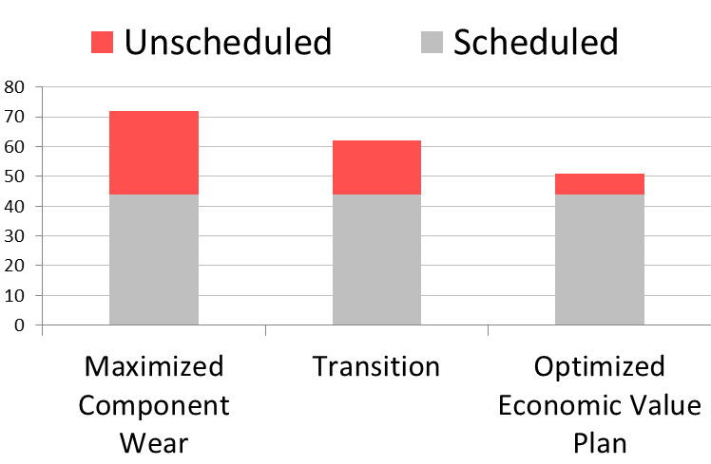
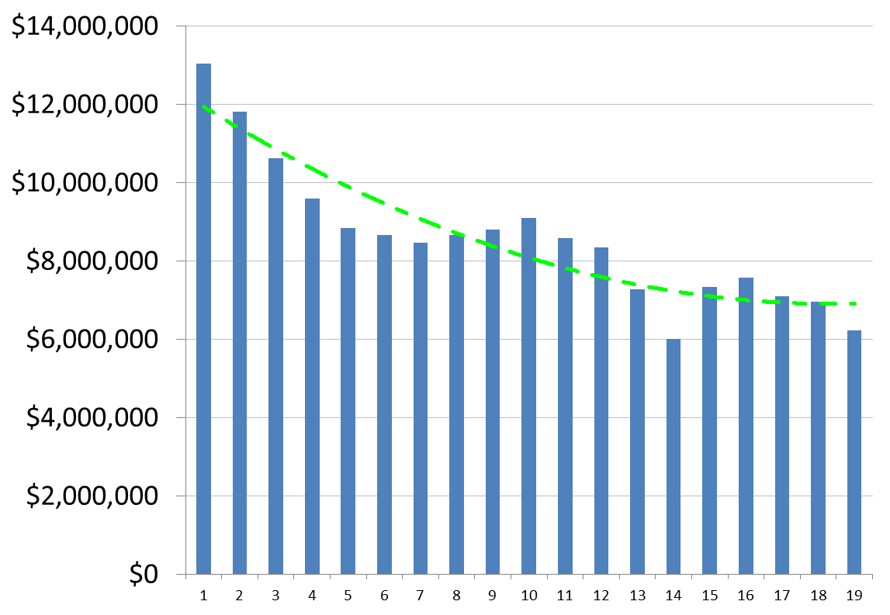
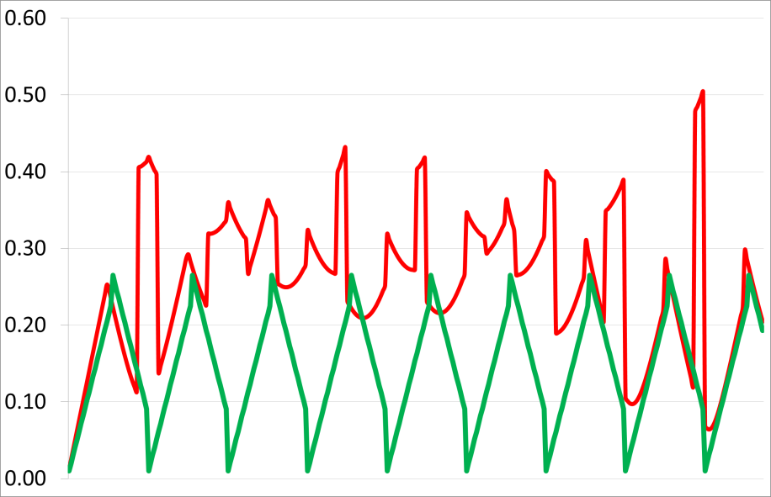
Undercarriage Strategy Analysis
We sliced, diced and crunched the numbers – our “Optimized Economic Value and Modification” strategy will extend undercarriage mission life at both Base Mine and Aurora North. Let’s rock.

Slide 20
Miscellaneous Tools
File Size Optimizer (includes programming)
turns hours of work into minutes
Piping Template
Reduces redundant and error-prone data entry with automation
various KPI tallies and attention flags.

Slide 21
Future
Compliance Phase 2 etc.
JFRT Summary, Extraction
Budget Management Facility

